Slide 1



Slide 2
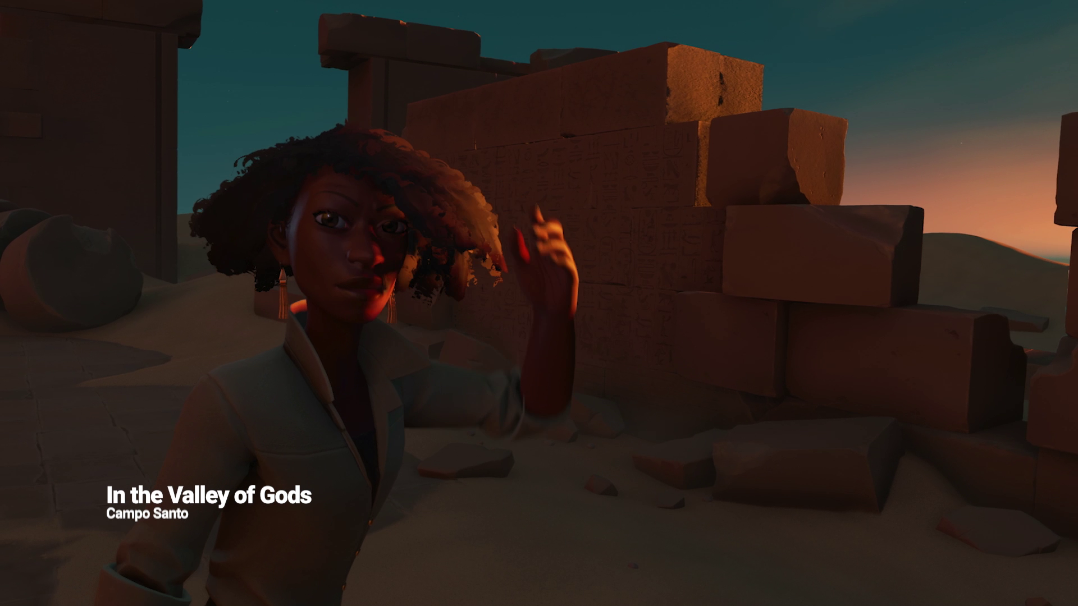

Slide 3
Unity tools to accelerate your MR Development

Slide 4
Arturo Nereu @ArturoNereu - arturo@unity3d.com

Slide 5
Get the project! github.com/ArturoNereu/UnityMRJam/

Slide 6
ProBuilder

Slide 7
TextMesh Pro

Slide 8
Timeline

Slide 9
Get the project! github.com/ArturoNereu/UnityMRJam/

Slide 10
Thank you! @ArturoNereu - arturo@unity3d.com

